Slide 1
BUSINESS COMMUNICATION PRESENTATION
What if we traded employees like football players?
BY
AKHASHAVANNAN M
COMIT ID : XBBNLN5

Slide 2
About this talk:
What would happen if new companies hired, fired, and managed in the same way as football clubs? What if new employers “bought” their new hires, and paid old employers a fee, like Cristiano Ronaldo?
In this short talk, we will understand the consequence of playing the old corporate game by new rules.

Slide 3
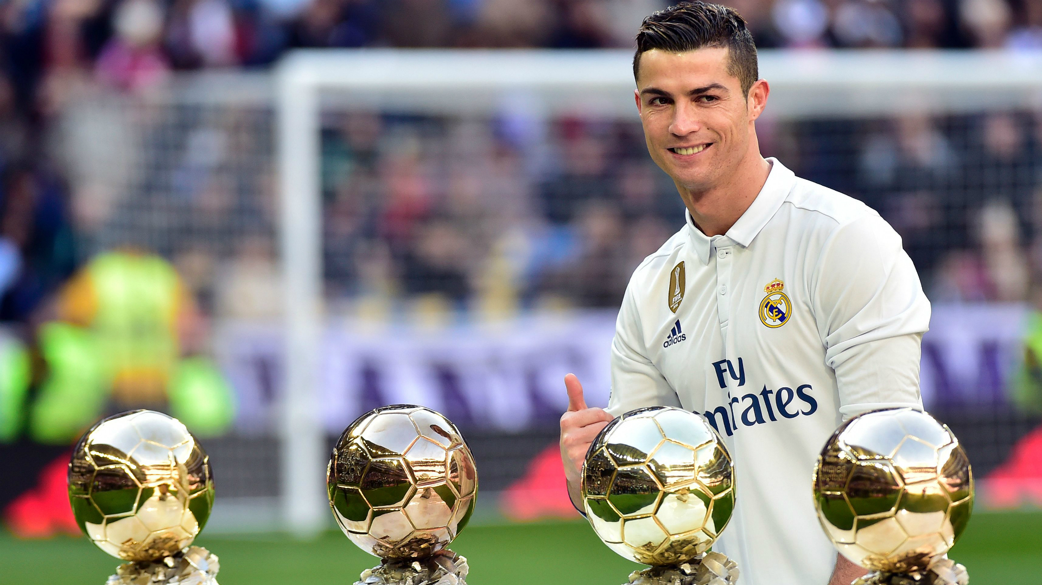

Slide 4
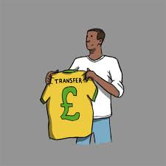
How football transfer works?
When professional footballers transfer teams, their original teams receives a fee. This is how much they value their players taking into account the time left on contract, the willingness to let them go and the amount they spent to develop them.

Slide 5
Famous example of this is Cristiano Ronaldo. He joined Manchester United at the age of 18 and over 6 years , the club’s manager has invested time, money and dedication to turn him into a world class football star . Real Madrid wanted his services.
To gain his services, they had to pay Manchester United 80 million pounds.
Ronaldo is an extreme transfer case and our businesses hire more like football teams.

Slide 6

Transfer Market across MNC’s
Here is some example to show how this might work. I joined this company as a young graduate. My manager would educate me, invest time and effort on me and would develop me to help their team and ultimately achieving our goals. They maybe much more employable having transferable skills.

Slide 7
If I find my real Madrid move, I could do that for free. My manager would not be rewarded and the competitor will be reaping the benefit. In a transfer fee scenario, my manager may take a different tactic . They might think that they could turn us into a great employee . I could train him thoroughly and when time comes for him to move, I can get a reward.
This could intensify managers to be great coaches knowing that my performance will improve team’s financial performance as well

Slide 8


Slide 9

When resources are more than available
In this scenario, there could be so many employees in my team , too many of us relative to the amount of work that is available. The company may decide to cut cost by laying off their employees.

Slide 10
But imagine, in this scenario where company could sell their employee to company that want skilled employees instead . Managers would intensify continuously to train and develop their staffs. They may even look to sell their best employee who is looking for a high fee to avoid more coachable people go.
Employee will not be made redundant and a new employer would pay to get a superstar employee to hit the ground running.
“EVERYONE WINS”

Slide 11
CONCLUSION
This idea is possible and it can be exploited , but its worth exploring. Perhaps testing with the way that we internally mobilize employees.
If great managers are rewarded for their efforts and get transfer fee in their budget , we would have a better, more productive, stronger workforce.

Slide 12


